Slide 1
Ulinkers
Acceptance Presentation
Teh Kaixin
Nabilah Banu
Sean Kwok
Nicole Goh
Chien Shu Yan
Notes:
1. Introduction of team, problem and solution. (10 mins)
2. Demo (15 mins)
3. Project plan (10 mins) <- top 3 risks
4. X factor and learning outcome (5 mins)

Slide 2

Agenda
Introduction
Problem and Solution
Project Management
Project Development
User Testing
Learning Outcomes

Slide 3


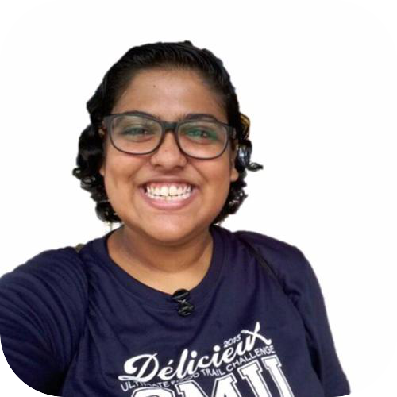
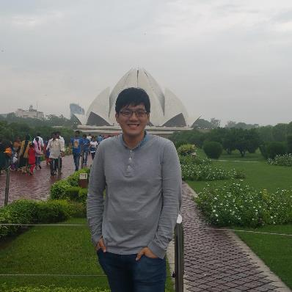
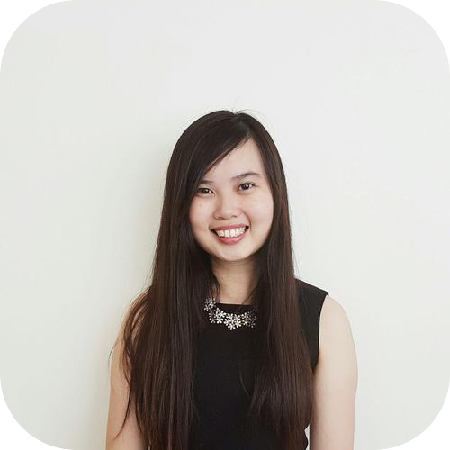
Team Members
Ulinkers
Nicole Goh
Teh Kaixin
Nabilah Banu
Lead Frontend Developer
Project Manager
Deputy Quality Assurance
Business Analyst
Deputy Backend Developer
Sean Kwok
Chien Shu Yan
Lead Backend Developer
Lead Quality Assurance
Deputy Frontend Developer

Slide 4

Operating since 1996
Medical concierge provider
Clinic and hospitalisation arrangements
Treatment plans and price estimates
Travel arrangements and visas
Standby assistance in Singapore
Most patients based in or visitors to Indonesia, Malaysia, Cambodia, Vietnam, Myanmar and China.
Makes more than 1000 appointments every year
Our Sponsor
Linda Siow, Executive

Slide 5
PROBLEM
Unable to keep track of teams’ performances
Lack of a timeline function to input research for recommended screenings
Views are not optimised
Client’s records are duplicated
Difficult to determine most number of referral, doctors, specialty

Slide 6

Solution
Ulink Web application
Analytical tools for decision making
(Specific KPI of different teams, Gender and Age, Top-k referral, doctor, specialty)
1
2
Timeline function for recommended screenings
Optimised views
(reduce duplicates, group by client name)
3

Slide 7
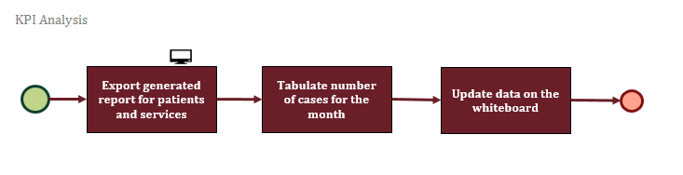
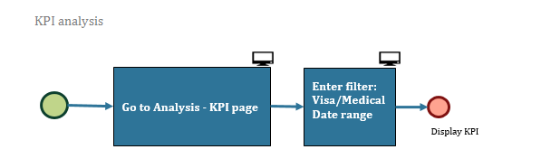
Solution
Workflow
AS-IS
TO-BE

Slide 8
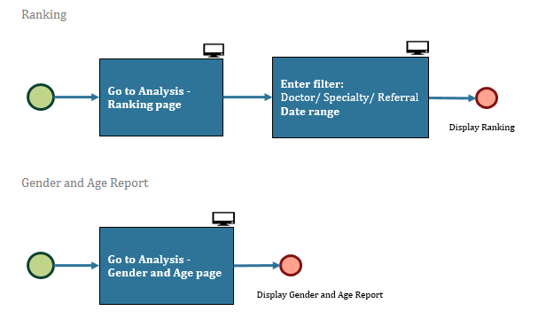
Solution
Workflow
TO-BE
TO-BE

Slide 9
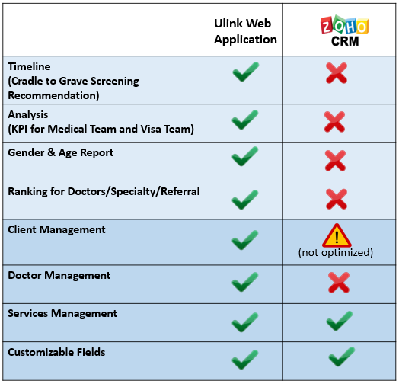
Market Research

Slide 10

DEMONSTRATION

Slide 11
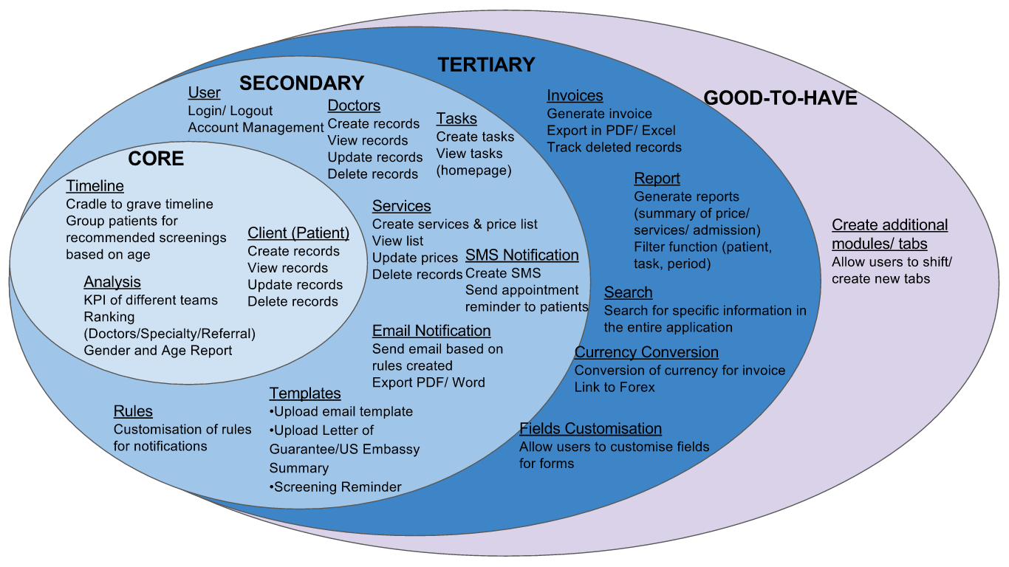

Project Management
Scope

Slide 12
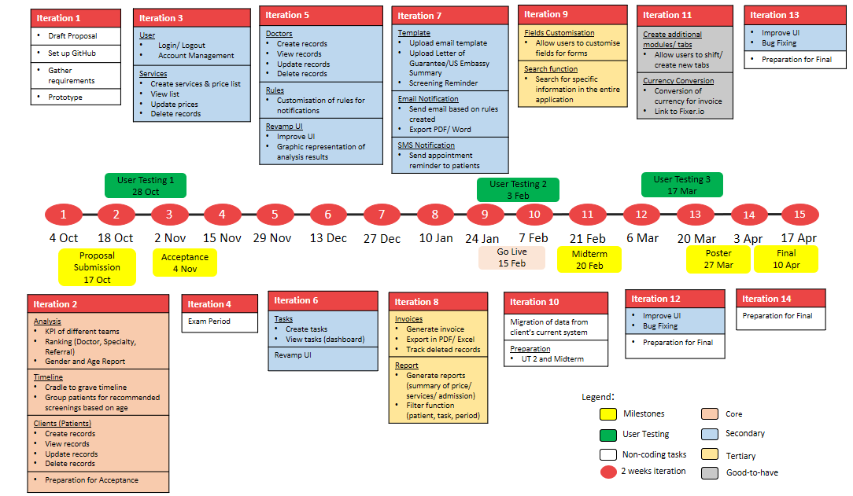
Project Management
Schedule

Slide 13
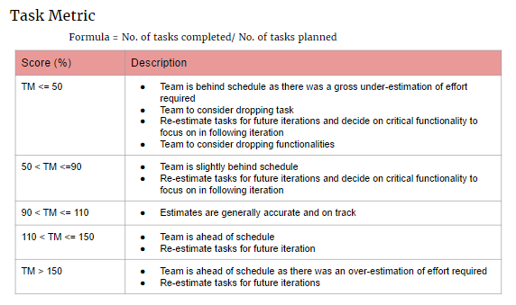
Project Management
Task Metric
Iteration 2
Planned: 3
Actual: 3
TM Score: 100%
Status: Completed

Slide 14
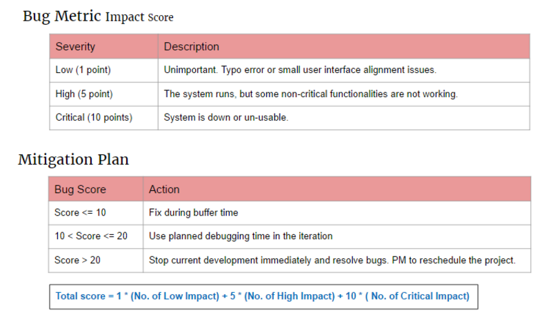

Project Management
Bug Metric
Iteration 2
Bug Score:

Slide 15
Project Management
RISK MANAGMENT
Risk | Risk Event | Likelihood | Impact | Mitigation
Project Management Risk | Allocation of too much/ little time for development of functions | Medium | High | Include buffer days before final submission. Allocate more time to develop complex functions.

Slide 16
Project Management
RISK MANAGMENT
Risk | Risk Event | Likelihood | Impact | Mitigation
Technical Risk | Unfamiliar with coding language like JavaScript and jQuery | Medium | High | More experienced developer to share knowledge and developers to research and learn technologies required.

Slide 17
Project Management
RISK MANAGMENT
Risk | Risk Event | Likelihood | Impact | Mitigation
Human Risk | Team member is not available due to illness or unforeseen circumstances | Medium | Medium | Each member has dual role to take over member who is unavailable.

Slide 18
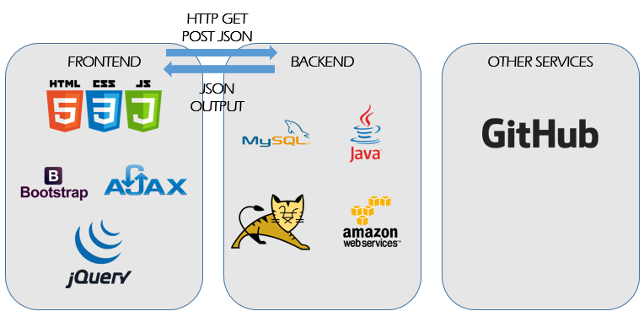
TECHNICAL
ARCHITECTURE DIAGRAM

Slide 19
User Testing 1
Ulink Assist Pte Ltd
1 User
Usability of UI
OCTOBER
28

Slide 20


UT 1 Feedback
User-friendly
Easy to navigate
Design is not intuitive
Naming of columns and fields are confusing
Notes:
Client prefers to choose which patient to send email to instead of automated sending of email
Analysis results to be in numbers

Slide 21
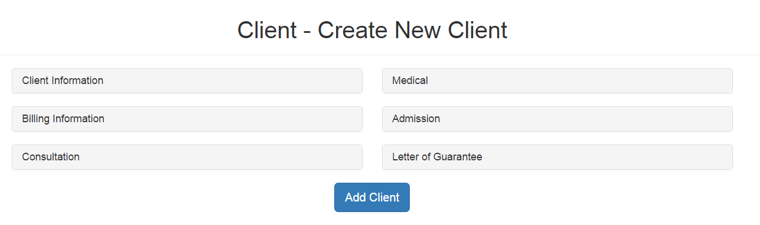
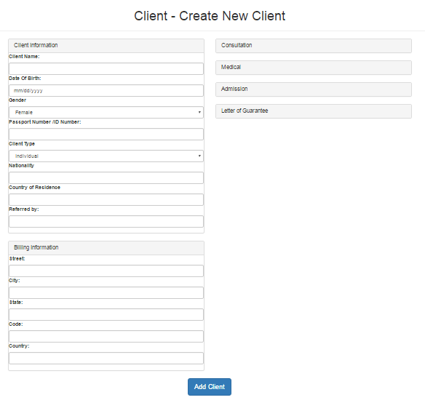
UT 1 Feedback
Changes Made
Display all fields for Client and Billing information in Client creation form

Slide 22
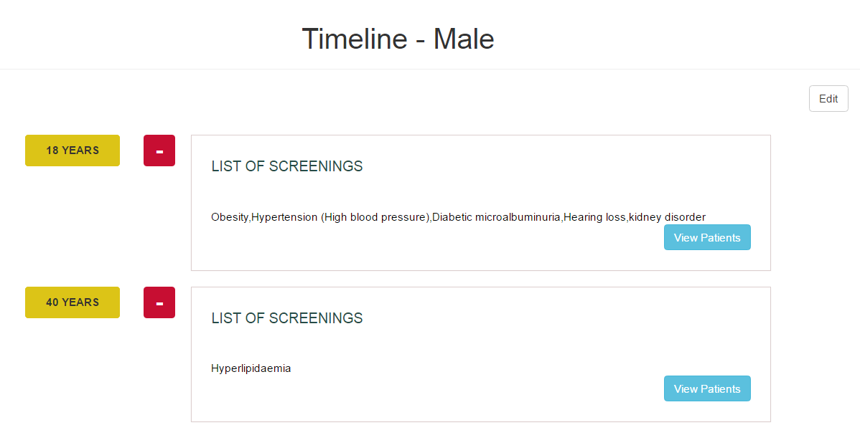
UT 1 Feedback
Timeline display is not intuitive, user suggested to change to table format
Client prefers to choose which patient to send email to instead of automated sending of email

Slide 23
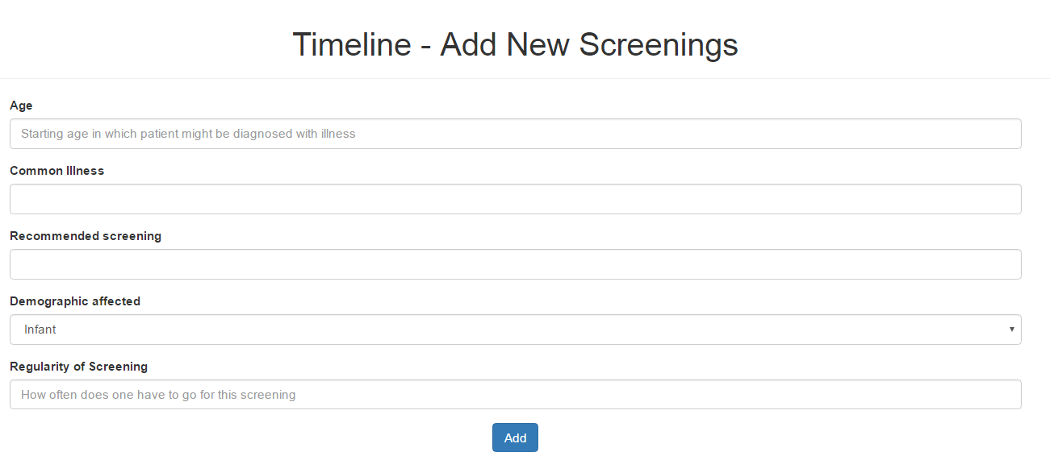
UT 1 Feedback
Add New Screening form to change in "Regularity" field to "Frequency of Screening (In Years)" for easy understanding

Slide 24
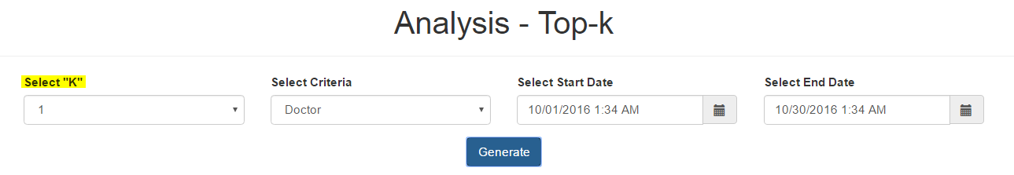
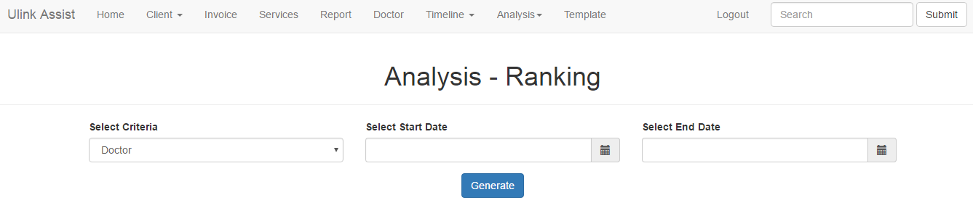
UT 1 Feedback
Changes Made
Top-K function to rename as "Ranking" for easy understanding
Remove “Select “K”” field and just display information in a table

Slide 25
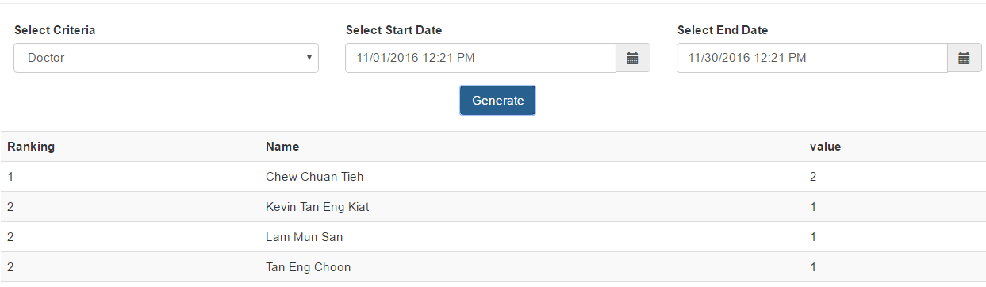
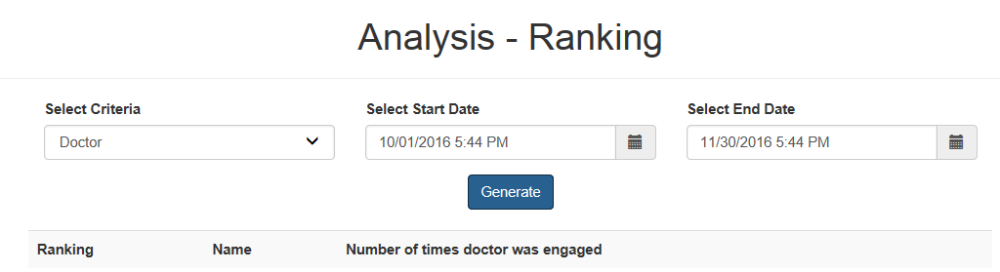
UT 1 Feedback
Confusing naming

Slide 26
X-FACTOR
5 users using the application
8 users with at least 5 interaction with the system per day

Slide 27
LEARNING OUTCOME
Shu yan
nicole
Learn to conduct UAT effectively to collect users feedback, analyse the feedback and devise solution catered to their needs
Gain more knowledge on UI development and improve communication skills
Sean
Have a better understanding on how technology can help my client have a better view of their business performance
Nabilah
Kaixin
Manage team and schedule effectively to deliver product on time
Apply knowledge of design processes and knowledge

Slide 28

Thank you

Slide 29
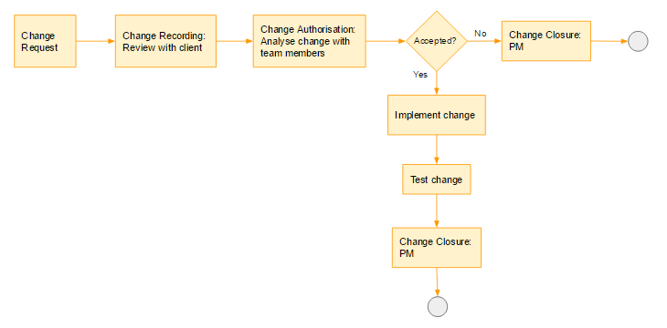
Project Management
Change Management

